Slide 1
Java User Group Philippines Meetup #2

Slide 2





Thanking the sponsors…
“The food is provided by Azul, who also provide fast and cost-efficient Java!”
“The venue is provided by O&B Software Labs”
“Free licenses by JetBrains”

Slide 3




Join the Community
Foojay Slack: bit.ly/join-foojay-slack
facebook.com/groups/jugph
meetup.com/java-user-group-ph/
twitter.com/jugphilippines

Slide 4
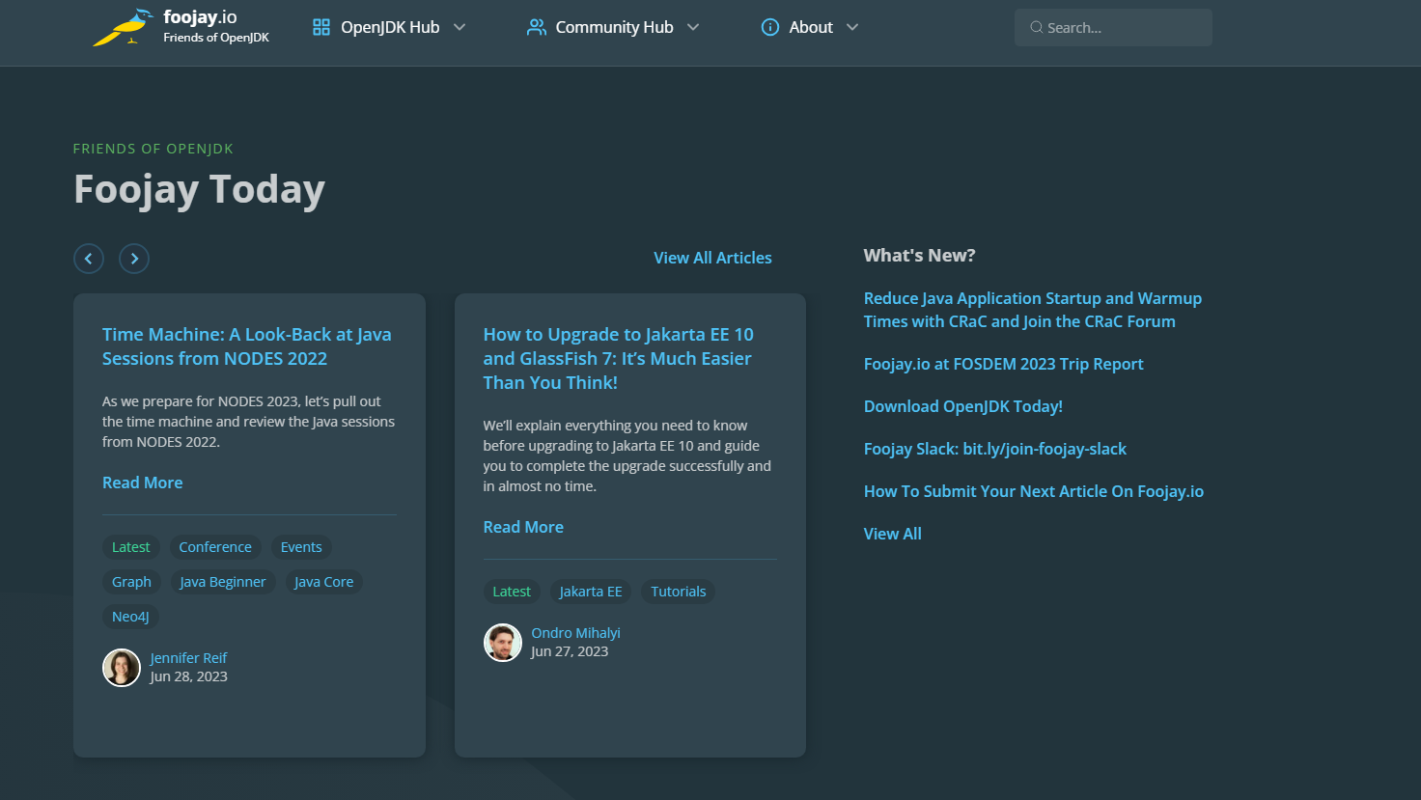
Checkout Foojay.io
https://foojay.io/

Slide 5
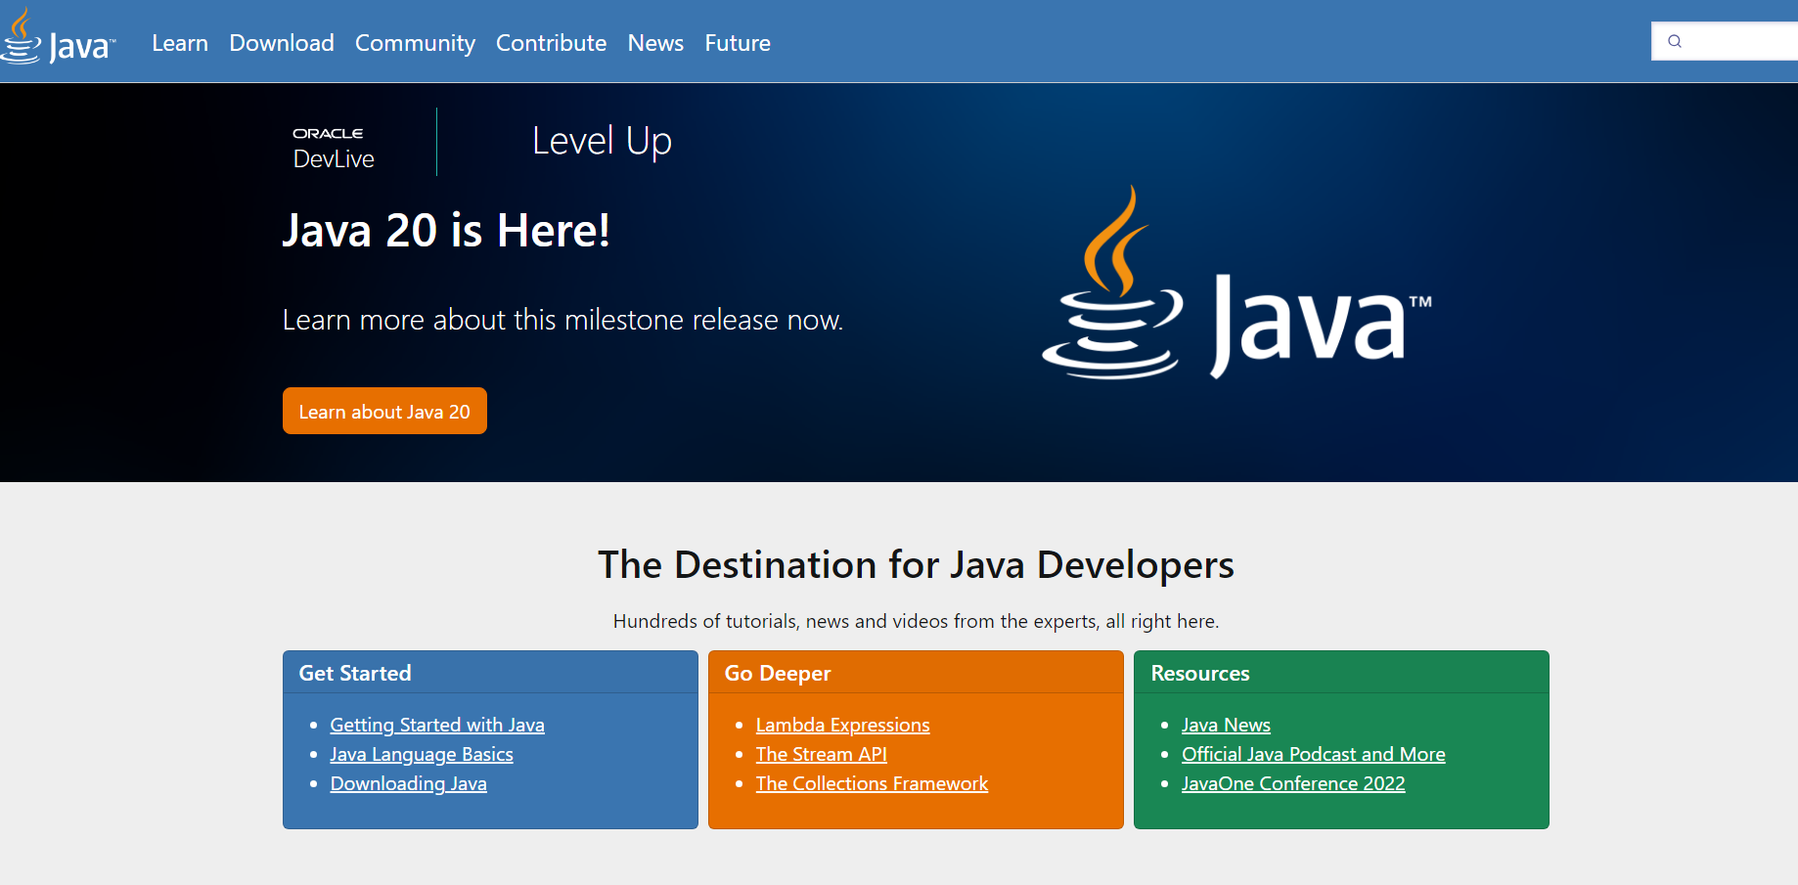
Checkout Dev.java
https://dev.java/

Slide 6
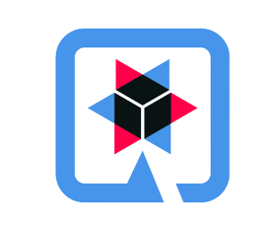

Quarkus and OpenShift Development

Slide 7
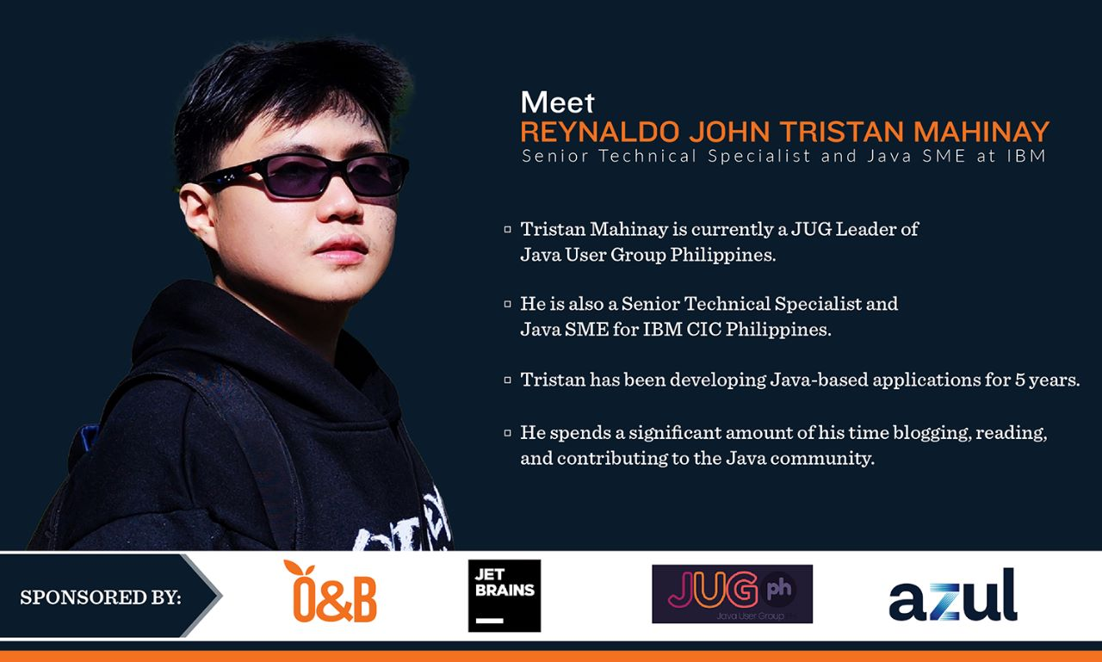

Slide 8




@ph_tantan
rjtmahinay
linkedin.com/in/rjtmahinay
facebook.com/rjtmahinay
me@rjtmahinay.com

Slide 9


What will the audience expect today?
Live coding using IntelliJ and Gradle
Deployment to RedHat OpenShift using an extension

Slide 10
What is Quarkus?
Support for Reactive Code
Kube-native
Cloud-native
Industry/Community Standards
Developer-Centric

Slide 11
Kubernetes-native
Increase productivity using built-in features of Kubernetes
Application Configuration
Health Metrics
Single-step Deployments (S2I) - using Quarkus Extension
Remote Development
Remote Development can be done by using the ff:
quarkus:remote-dev (Maven)
quarkusRemoteDev (Gradle)

Slide 12
Cloud-native
Low memory footprint
Reduced reflection
Fast boot time
Support for GraalVM

Slide 13
Support for Reactive Code
Support HTTP Microservices
RESTEasy Classic
Reactive Programming
RESTEasy Reactive
SmallRye Mutiny
Event-driven Applications
AMQP
Apache Kafka
Apache Camel
Function/Serverless
AWS Lambda
Google Cloud Functions
Azure Functions
Quarkus Funqy

Slide 14
Developer-Centric
Live Coding
Remote Development
DevUI
Can be access in development mode and by executing quarks:dev goal or quarkusDev task
Continuous Testing in DevUI
CLI

Slide 15
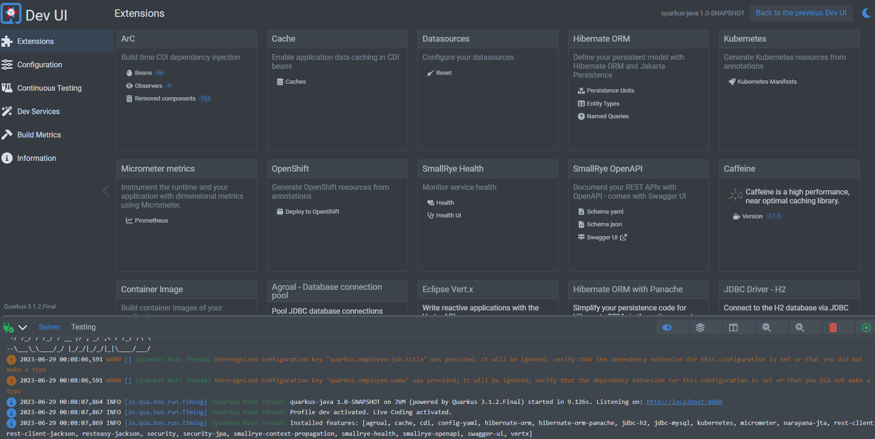
Dev UI

Slide 16
Industry/Community Standards
Support the usage of JAX-RS/JAX-WS, JPA, Microprofile, Vert.x, Micrometer, Spring Framework and so on..

Slide 17
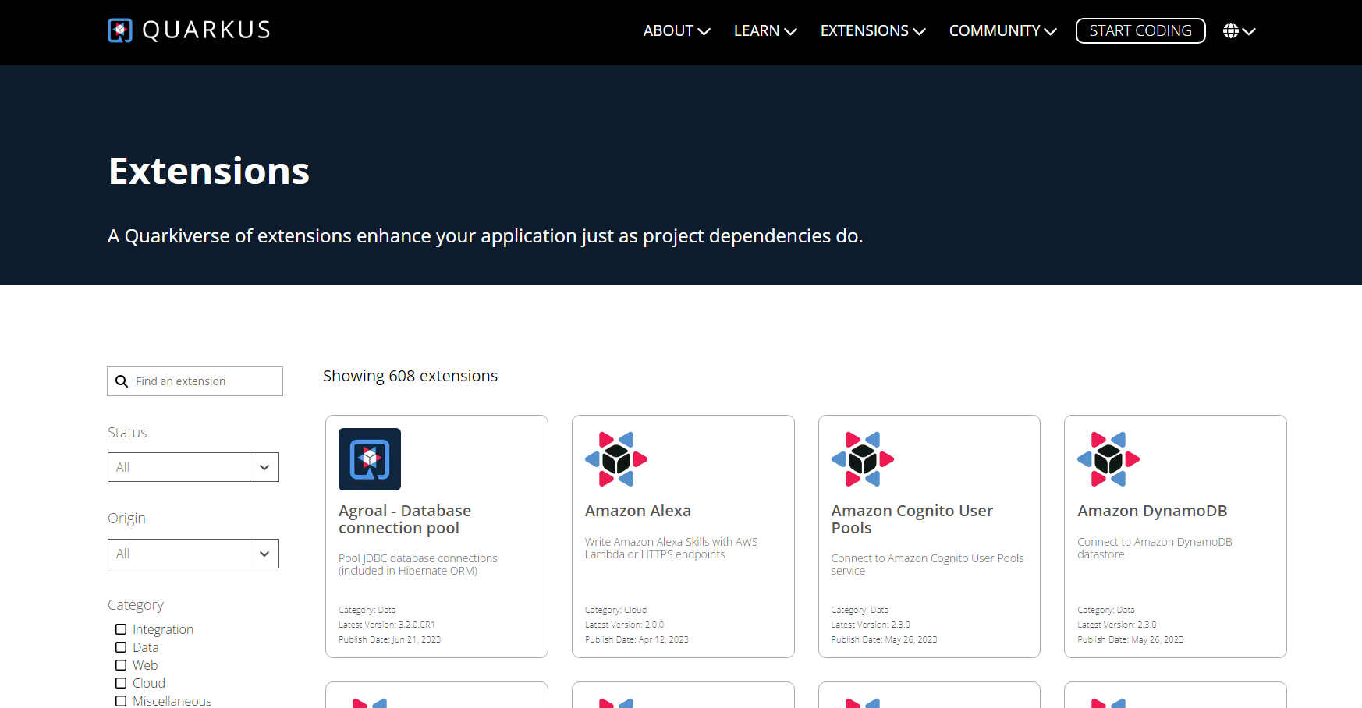
What is an extension?
https://quarkus.io/extensions/
Enhance your Quarkus applications just like a project dependency.

Slide 18
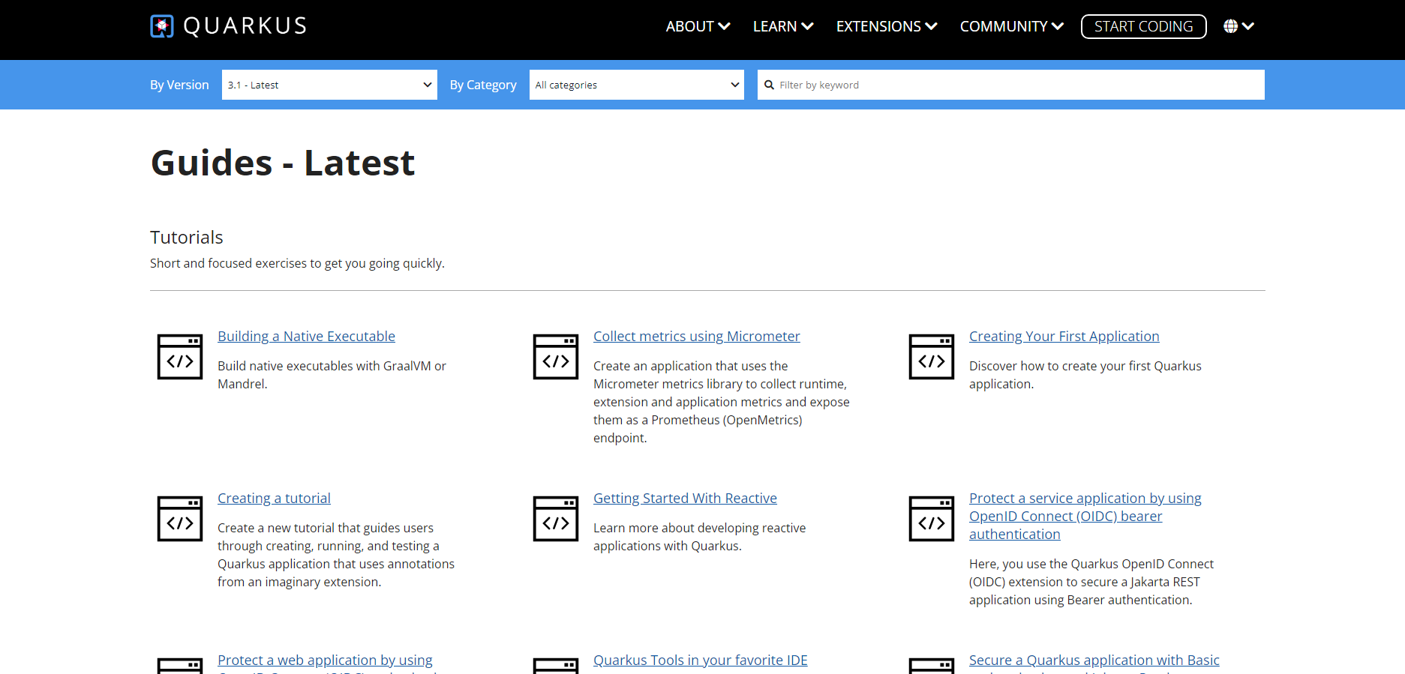
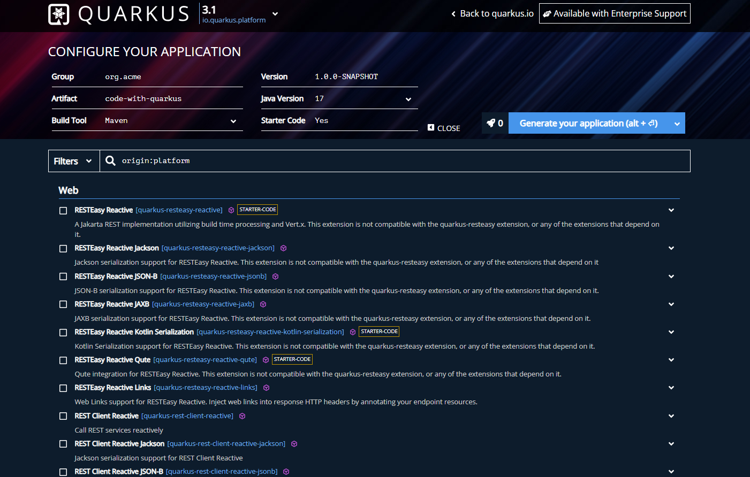
Where to start?
Quarkus Documentation
https://quarkus.io/guides/
Quarkus Initializer
https://code.quarkus.io/

Slide 19
Demo

Slide 20
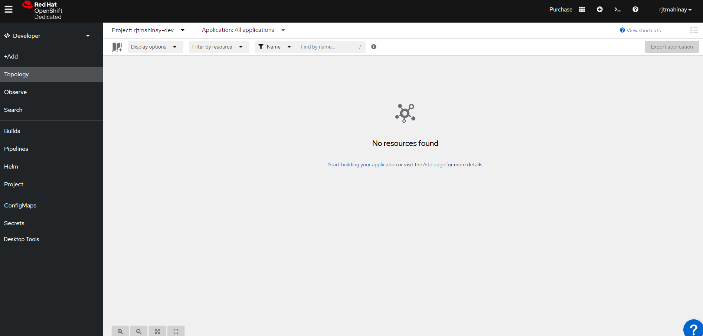
What is OpenShift?
Kubernetes-based Platform
Hybrid Cloud

Slide 21
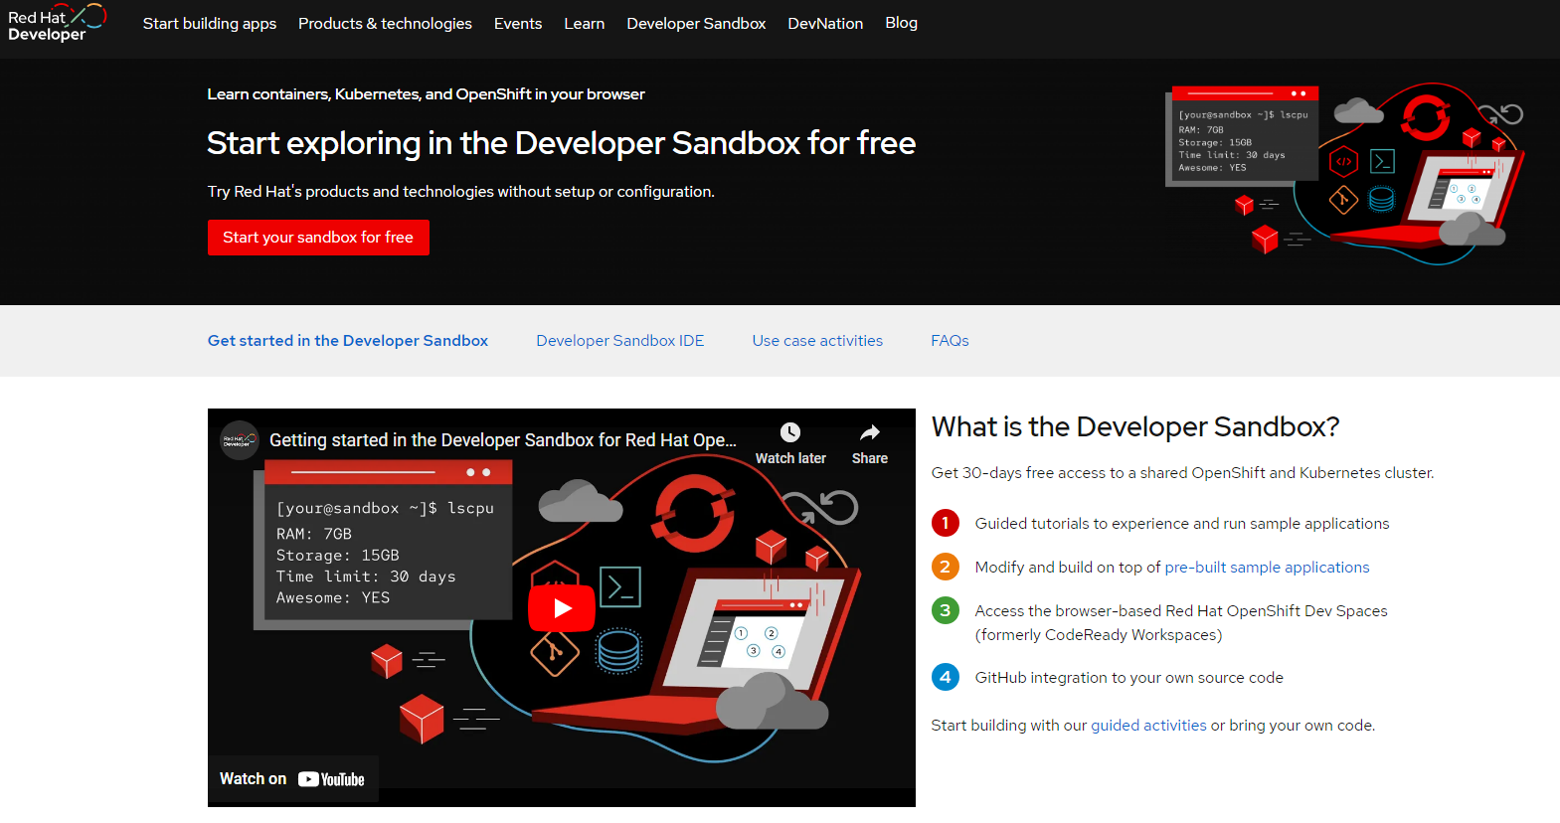
OpenShift Sandbox
Visit: https://developers.redhat.com/developer-sandbox
30 days access
Data are deleted after the given period but you can provision a sandbox again.

Slide 22
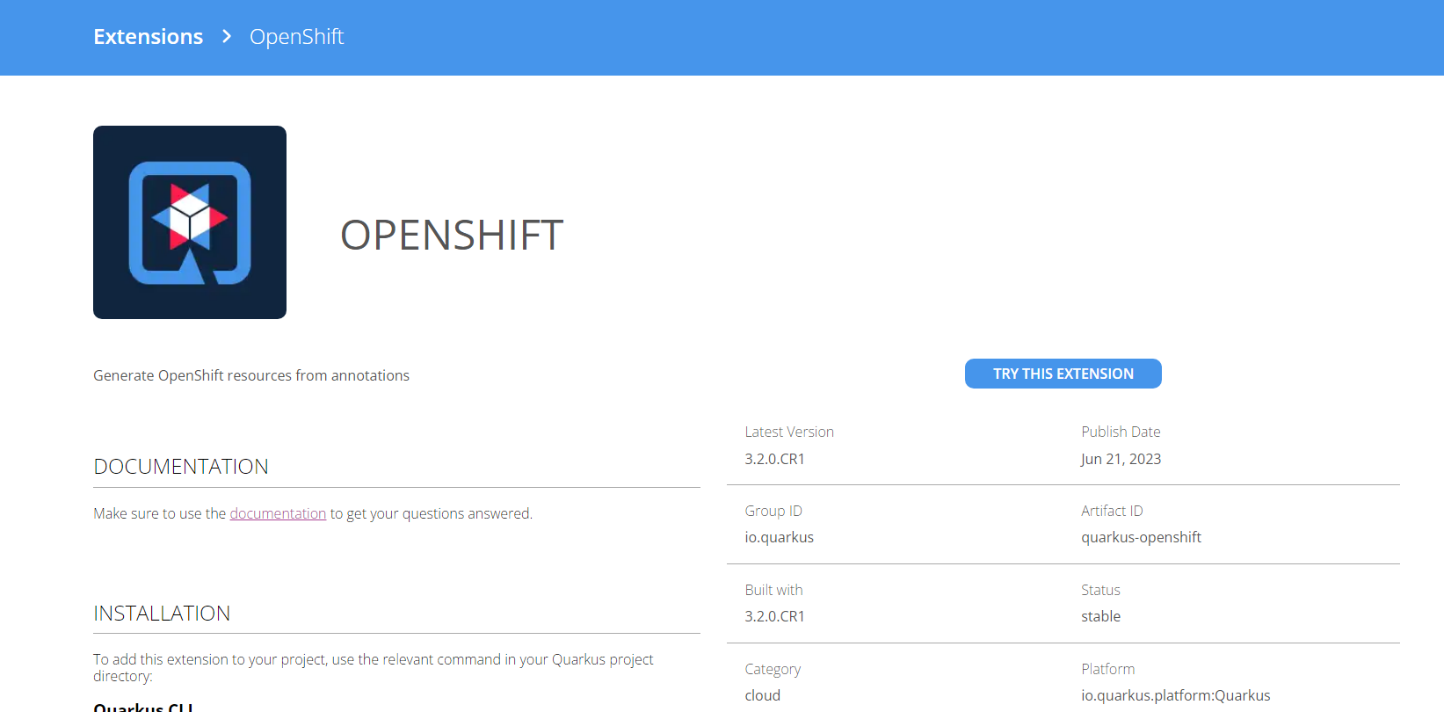
What is S2I?
Source-to-Image (S2I) is a framework that makes it easy to write images that take application source code as an input and produce a new image that runs the assembled application as output.

Slide 23
Demo

Slide 24
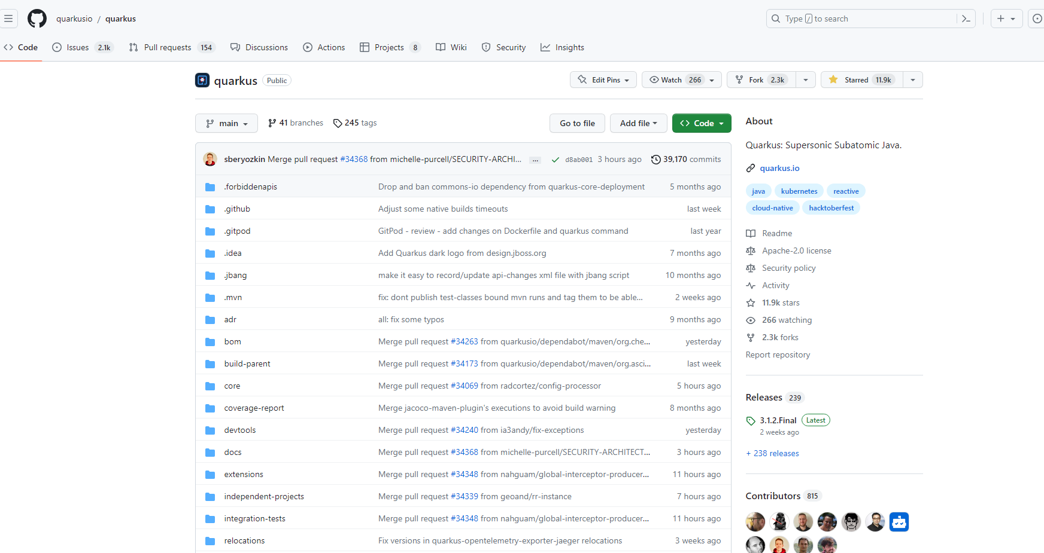
Want to contribute to Quarkus?
https://github.com/quarkusio/quarkus

Slide 25
Q & A

Slide 26
Raffle

